Slide 1

SPACE MISSION DATA ANALYSIS
Presented by: V. Monika
Department: AI & Data Science

Slide 2




Introduction
Why space mission data matters
Space missions generate large amounts of data.
This project analyzes space mission data using Python.
We study mission details and launch success.
Machine Learning is used to predict launch success.

Slide 3
Objectives
Analyze space mission data.
Find patterns in mission information.
1
2
Visualize the data using graphs.
Predict launch success using Machine Learning.
3
4
Understand the factors affecting mission outcomes.
5

Slide 4




Technologies Used
Python
Pandas
Matplotlib
Seaborn
Scikit-learn
Core language
Data handling
Visualization
Advanced viz
Machine Learning

Slide 5
Dataset
20 real missions (2018-2024) across 4 countries and 5 space agencies
Fields
First 5 records (script output)
Year | Country | Org | Mission | Payload | Type | Outcome
2018 | India | ISRO | GSLV Mission | 2200 | Satellite | Success
2018 | USA | NASA | Mars Mission | 3000 | Mars | Success
2018 | Russia | Roscosmos | Soyuz Mission | 2500 | Satellite | Success
2019 | India | ISRO | Chandrayaan-2 | 3850 | Lunar | Failure
2019 | USA | SpaceX | Starlink-1 | 15000 | Satellite | Success
Year
Country
Organization
Mission_Name
Payload_kg
Mission_Type
Outcome

Slide 6
Data Processing
1
2
3
Create the dataset.
Save it and load it with Pandas.
Check for missing values and duplicates.
4
5
6
Encode categorical columns using LabelEncoder.
Select important features.
Split data into training and testing sets.

Slide 7
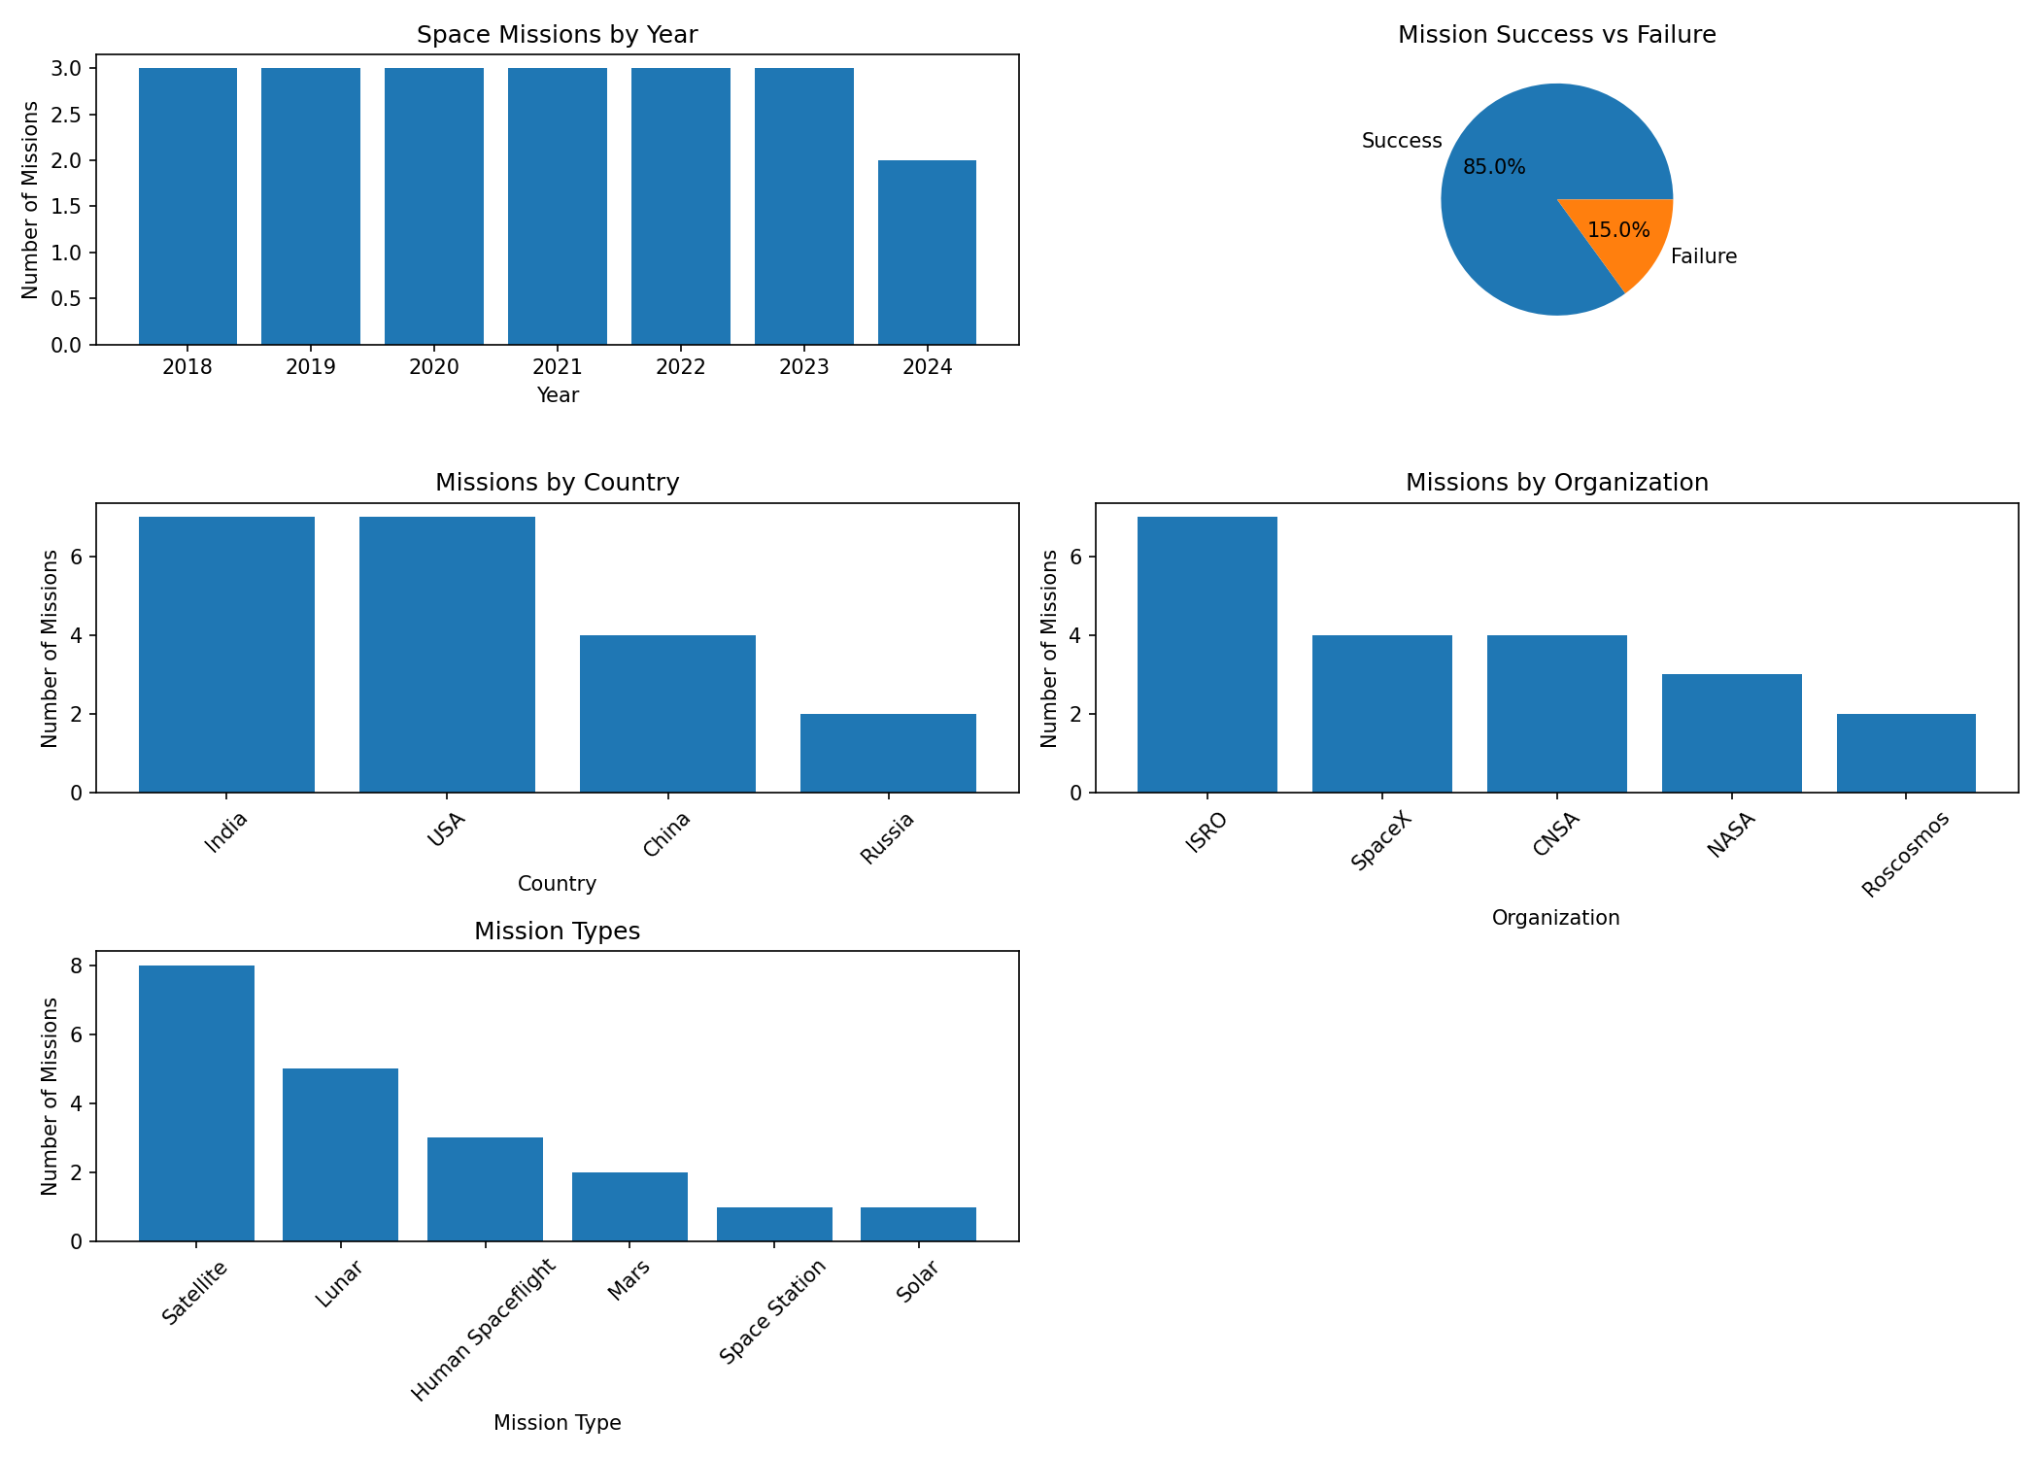
Data Visualization
Actual output from the Python script (matplotlib)

Slide 8




Machine Learning
We use Random Forest Classifier (100 trees).
Features: Year, Country, Organization, Payload, Mission Type.
It learns patterns from 16 training missions.
Random Forest Algorithm
Combines many decision trees into one strong model
Then it predicts the outcome for the 4 test missions.

Slide 9

Result
85%
100%
India
Mission Success Rate
Model Accuracy
Most Active Country (7)
Out of 20 missions, 17 succeeded and 3 failed (85% success rate).
Accuracy score evaluates how well the Random Forest model performs.
ISRO is the most active organization with 7 missions.
Note: with only 20 missions and 3 failures, the 100% test accuracy reflects a very small, imbalanced sample — not a production-ready model.

Slide 10
Conclusion
Space mission data can be analyzed effectively using Python.
Pandas helps in data processing.
Matplotlib and Seaborn help in visualization.
Random Forest helps in predicting launch success.
This project gives a basic understanding of Data Analysis + Machine Learning.
Thank You!

